Slide 1

Collaborating for the Advancement of Interdisciplinary Research in Benign Urology
Collaborating for the Advancement of Interdisciplinary Research in Benign Urology
Kristina L. Penniston, PhD
Distinguished Senior Scientist
University of Wisconsin-Madison

Slide 2



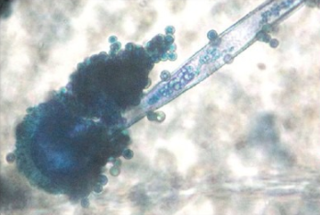
Non-Cancerous Urologic Conditions
Hundreds of millions worldwide affected
Not so “benign”
  Infection
  Prostate and male reproductive problems
  Neurological (“neuro-uro”) disorders
  Bladder and lower urinary tract symptoms
  Congenital anomalies
  Urolithiasis
High cost, hidden burden
CAIRIBU Website URL: https://cairibu.urology.wisc.edu
Collaborating for the Advancement of Interdisciplinary Research in Benign Urology

Slide 3
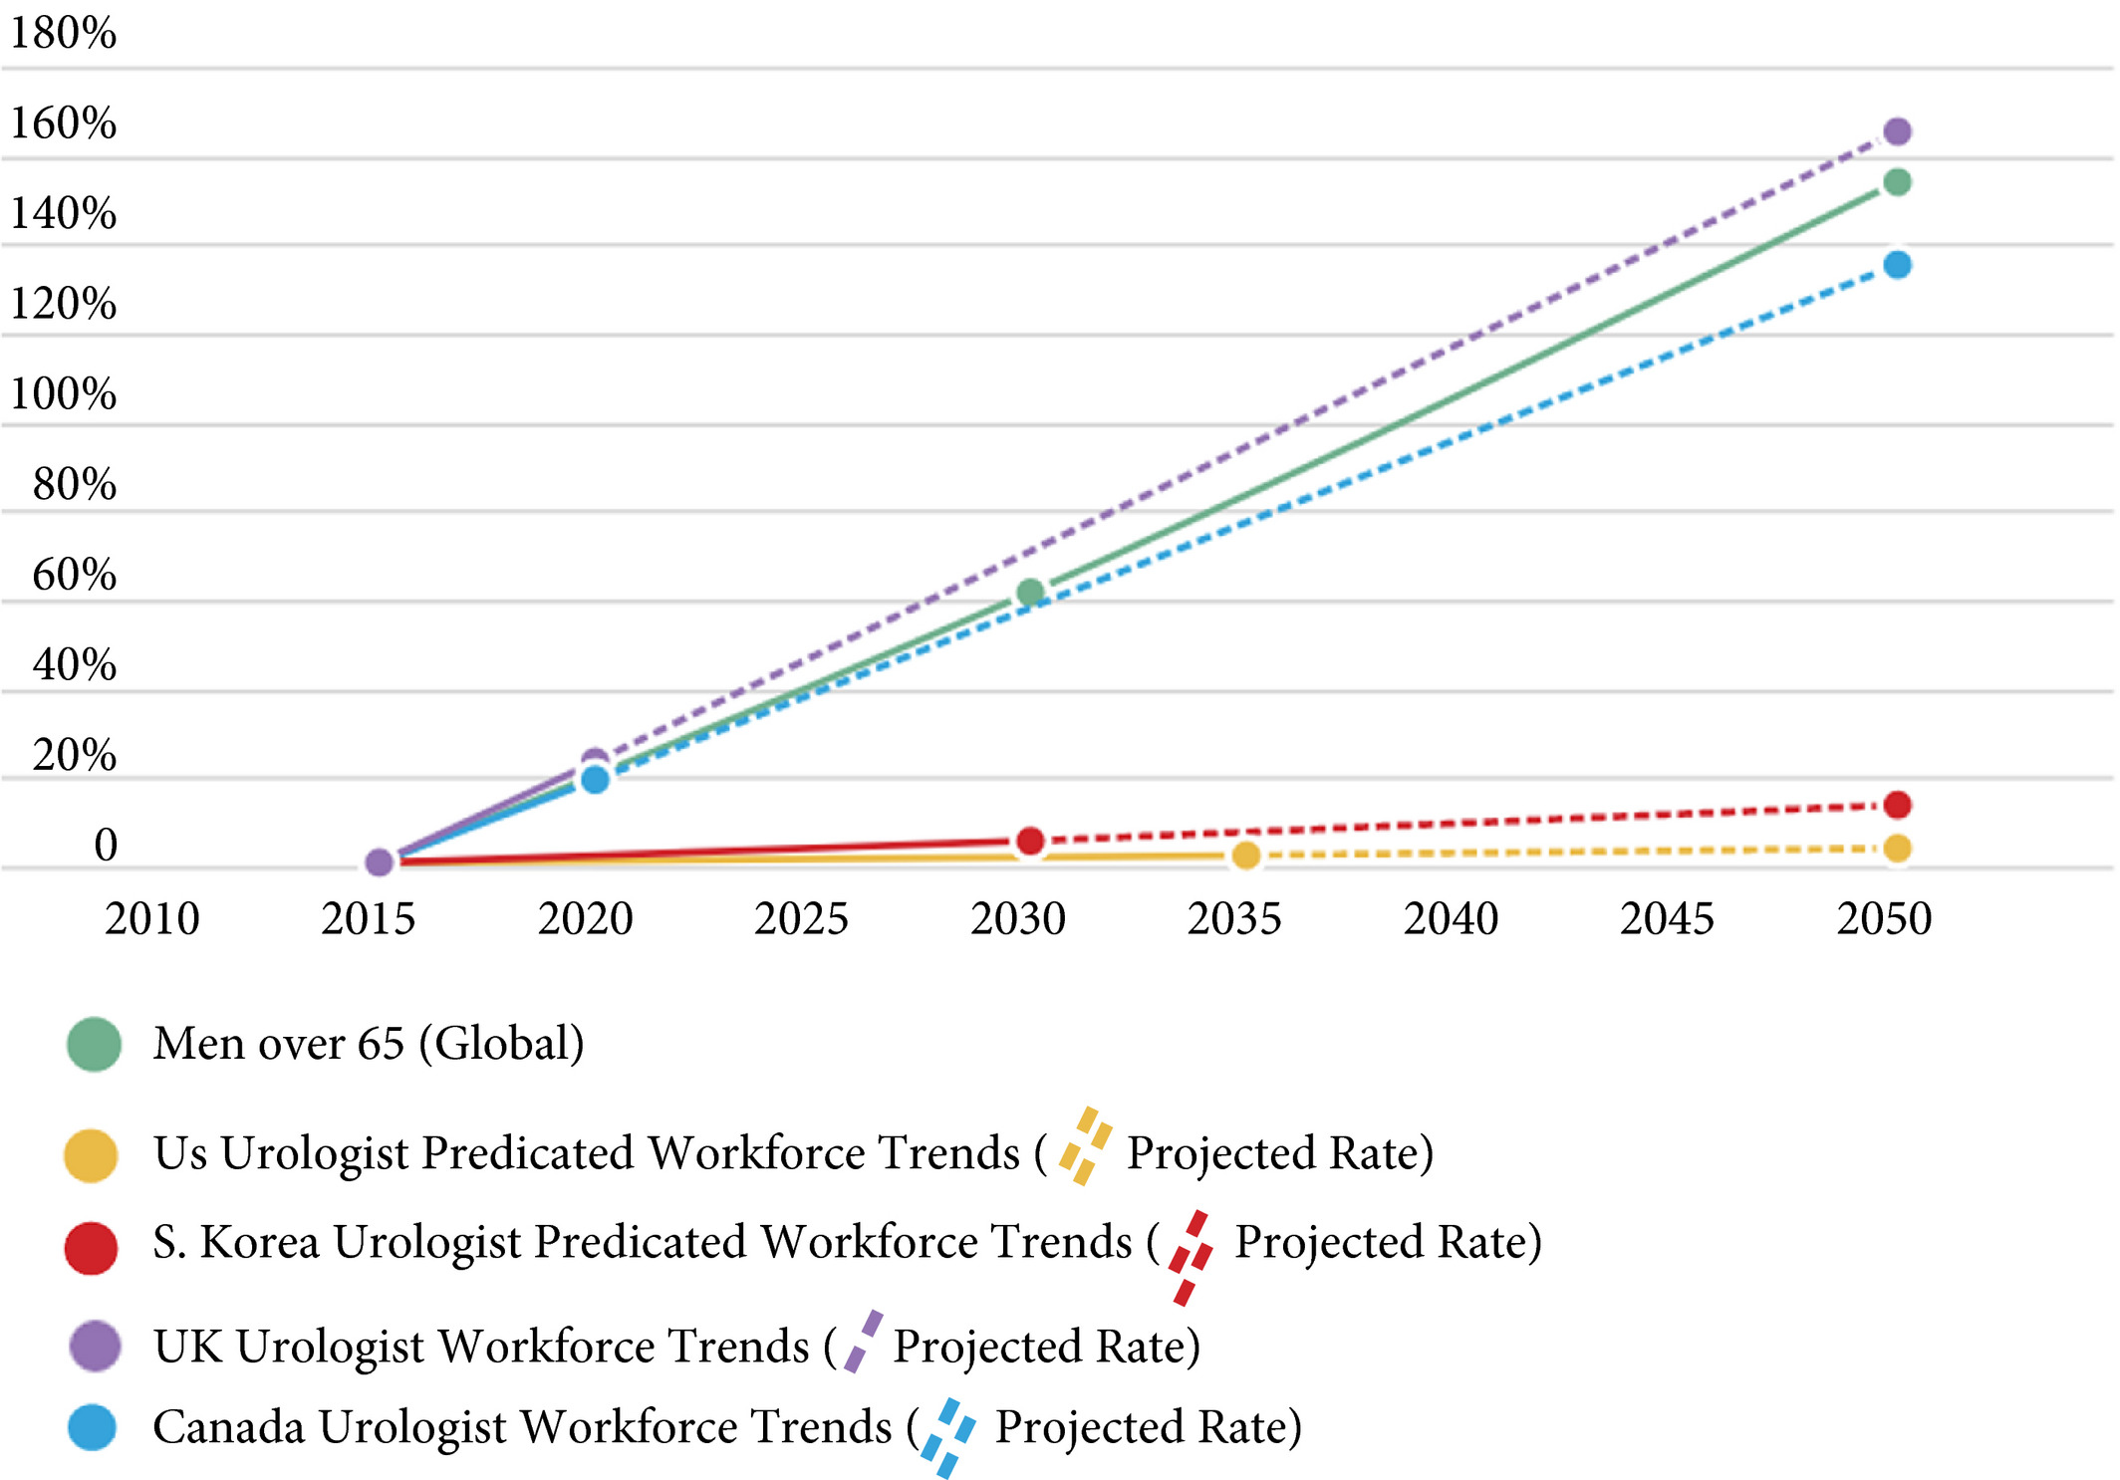
Greater Need But Fewer Providers, Less Research
Rising world impact of BPH but fewer providers – mirrors other so-called benign genitourinary conditions
OPPORTUNITY:
Room for MORE urologists and urogynecologists – as well as research scientists – to treat and study benign urologic conditions
Work from the UW-Madison George M. O’Brien Center (PI, Will Ricke, PhD): Launer et al, BJU Int 2020;127:722-28
Collaborating for the Advancement of Interdisciplinary Research in Benign Urology
Notes:
Percentage change in global population of men over time as compared to first‐world urological workforce trends.
IF THIS IMAGE HAS BEEN PROVIDED BY OR IS OWNED BY A THIRD PARTY, AS INDICATED IN THE CAPTION LINE, THEN FURTHER PERMISSION MAY BE NEEDED BEFORE ANY FURTHER USE. PLEASE CONTACT WILEY'S PERMISSIONS DEPARTMENT ON PERMISSIONS@WILEY.COM OR USE THE RIGHTSLINK SERVICE BY CLICKING ON THE 'REQUEST PERMISSIONS' LINK ACCOMPANYING THIS ARTICLE. WILEY OR AUTHOR OWNED IMAGES MAY BE USED FOR NON-COMMERCIAL PURPOSES, SUBJECT TO PROPER CITATION OF THE ARTICLE, AUTHOR, AND PUBLISHER.

Slide 4
Benign Urology is Understudied... Why?
First -- the questions are kind of difficult. For instance, what is benign prostatic hyperplasia? We know the prostate starts growing as men age, particularly in a middle segment of the gland known as the transition zone. That phenomenon is rare, and it only happens in benign prostatic hyperplasia and during lactation when women breastfeed.
Also, there's really no advocacy for benign prostatic hyperplasia. There is a ton of advocacy from patients and government entities for finding treatments and cures for diseases like prostate, lung and kidney cancer, which all kill people. That means more funding.
So the research is difficult, the funding is scanty and the endpoints -- the things you measure to determine patient progress -- are subjective. One patient might wake up three or four times a night to urinate, but he isn't bothered by it. Another might wake up once and he's driven crazy. That makes research and treatment progress harder to track.
James Brooks, MD, PI, Stanford University George M. O’Brien Center
Collaborating for the Advancement of Interdisciplinary Research in Benign Urology

Slide 5
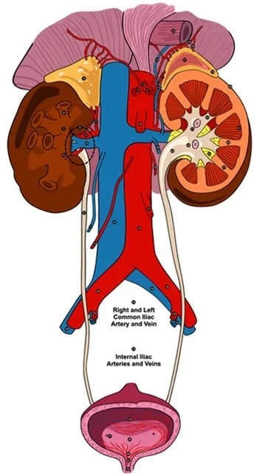
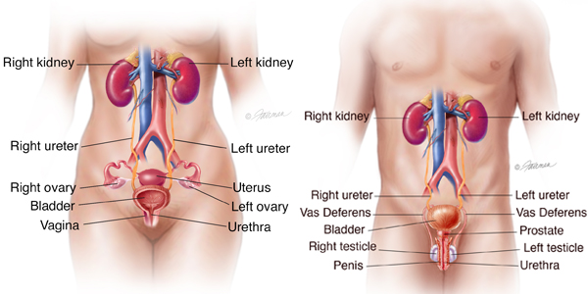
From the Urology Care Foundation website, https://urologyhealth.org

Slide 6
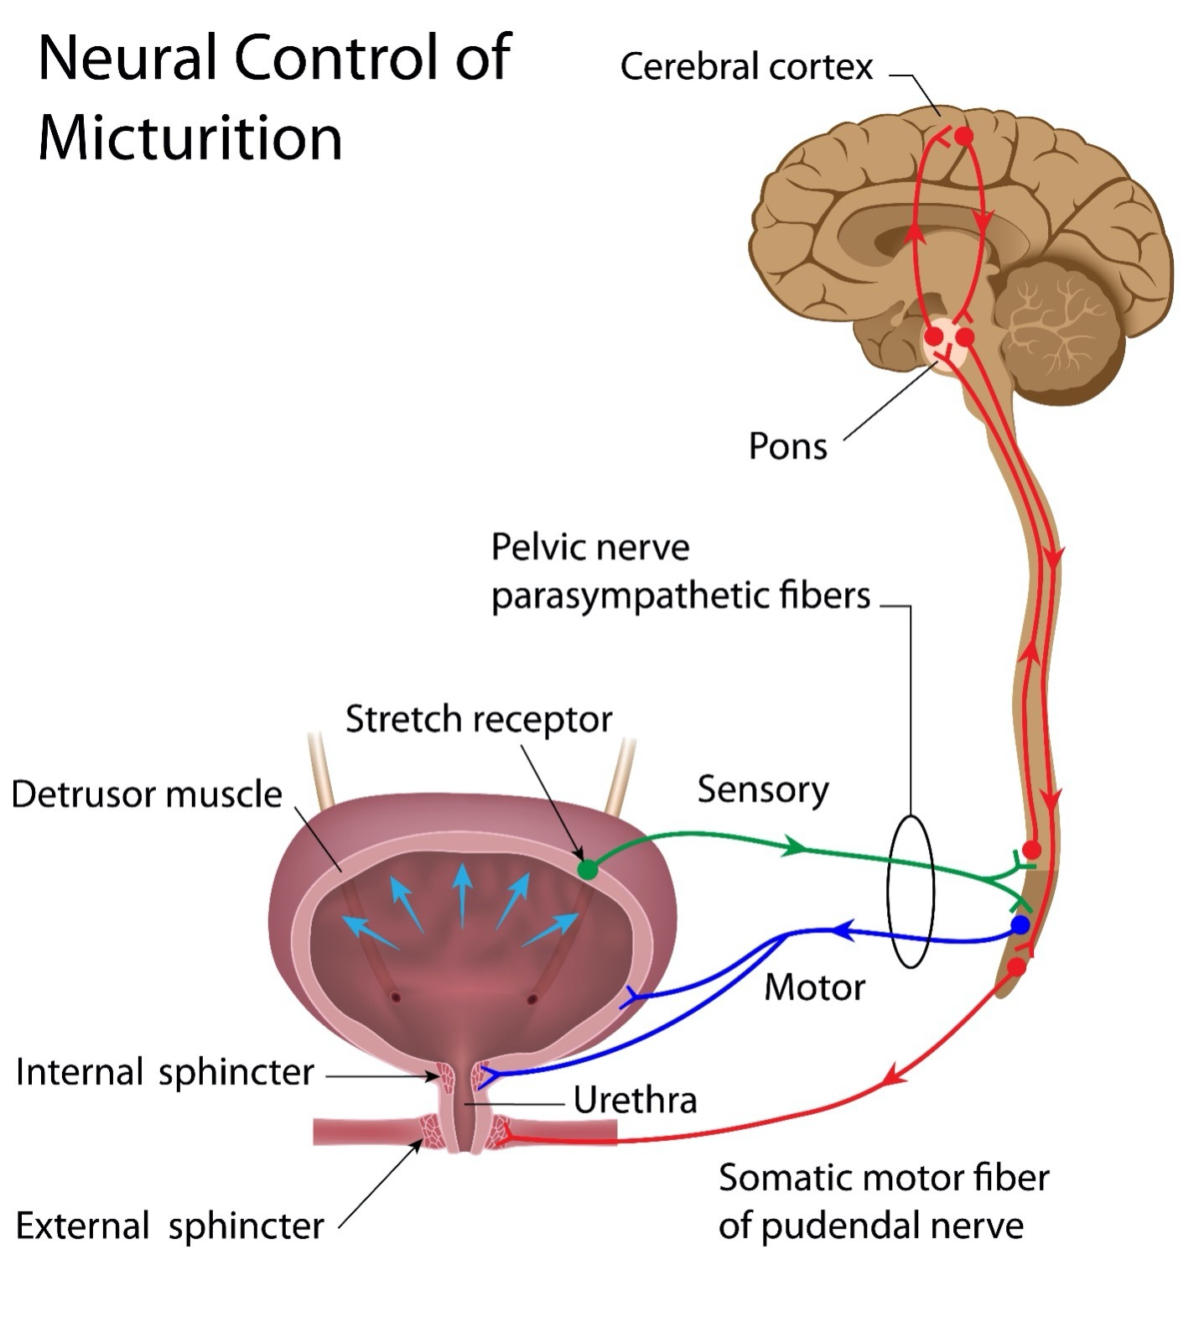
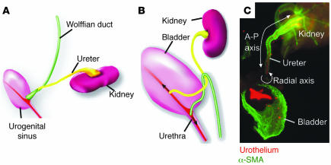
Kidney and Bladder Development and Function
Studies in the embryonic mouse urinary tract yield insights that answer questions about urinary obstruction and renal function in humans
Brain-Bladder Connection
Work from Columbia George M. O’Brien Center:
C Mendelsohn, J Clin Invest 2006;116:635-37
Collaborating for the Advancement of Interdisciplinary Research in Benign Urology

Slide 7
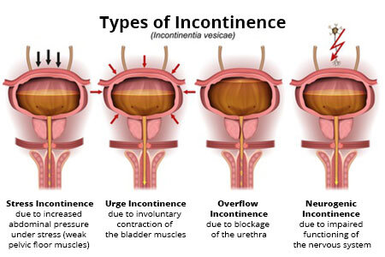
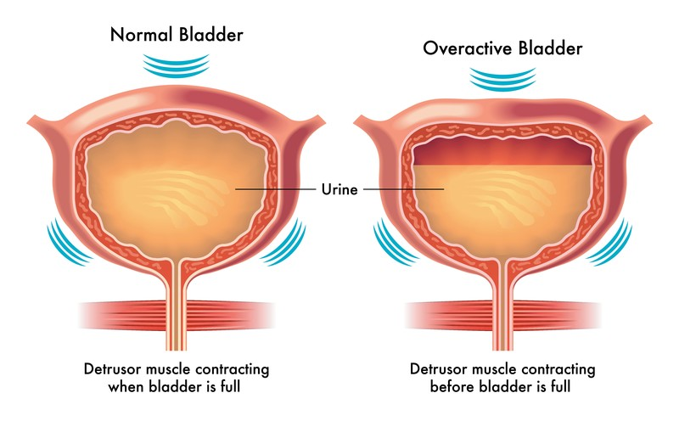
Bladder Dysfunction
Overactive Bladder
Some of the primary factors:
Inflammation, infection, hormonal perturbations
Environmental exposures – Diet, toxins
Comorbidities – Diabetes, cardiovascular disease, neurological disorders
Uncontrollables – Aging, genetics, congenital defects
Collaborating for the Advancement of Interdisciplinary Research in Benign Urology

Slide 8
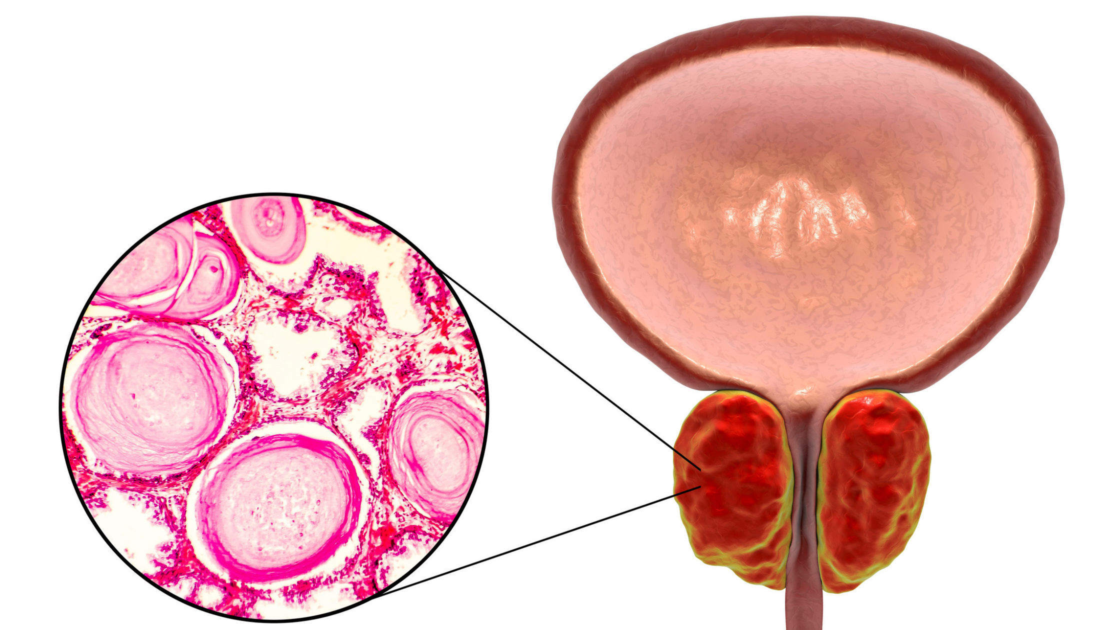
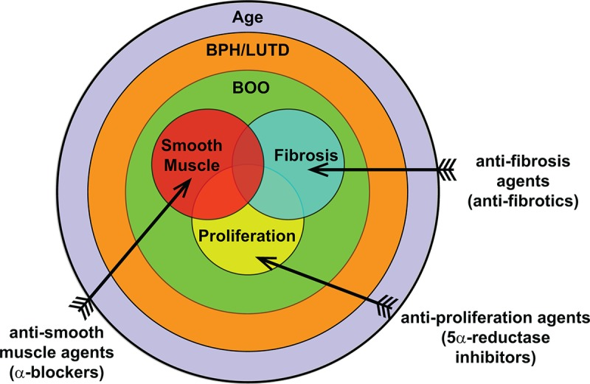
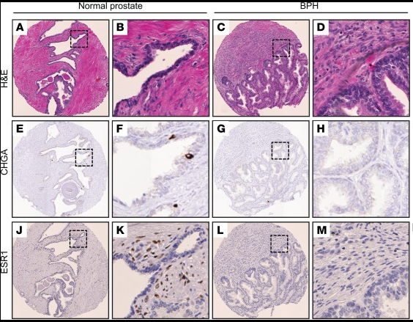
Prostate & Lower Urinary Tract Symptoms
Enlarged Prostate
From Stanford O’Brien Center:
Middleton et al, JCI Insight 2019;5(12)
From UW-Madison O’Brien Center:
Liu et al, Aging 2019;11(9)
Collaborating for the Advancement of Interdisciplinary Research in Benign Urology

Slide 9
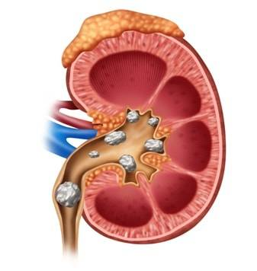
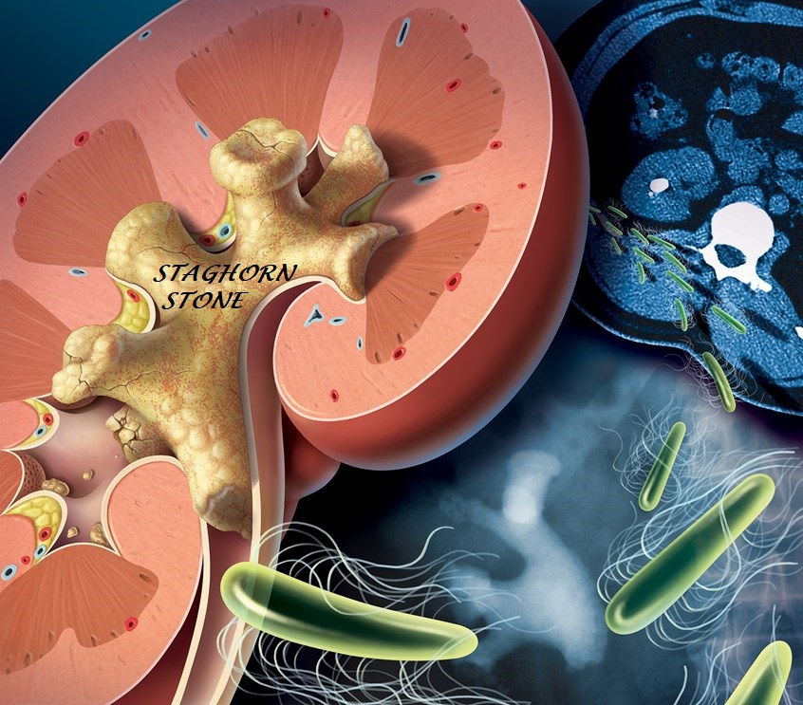
Urinary Tract Calculi
“Benign....???” Kidney stones don’t kill you – they just take away your life
Collaborating for the Advancement of Interdisciplinary Research in Benign Urology

Slide 10
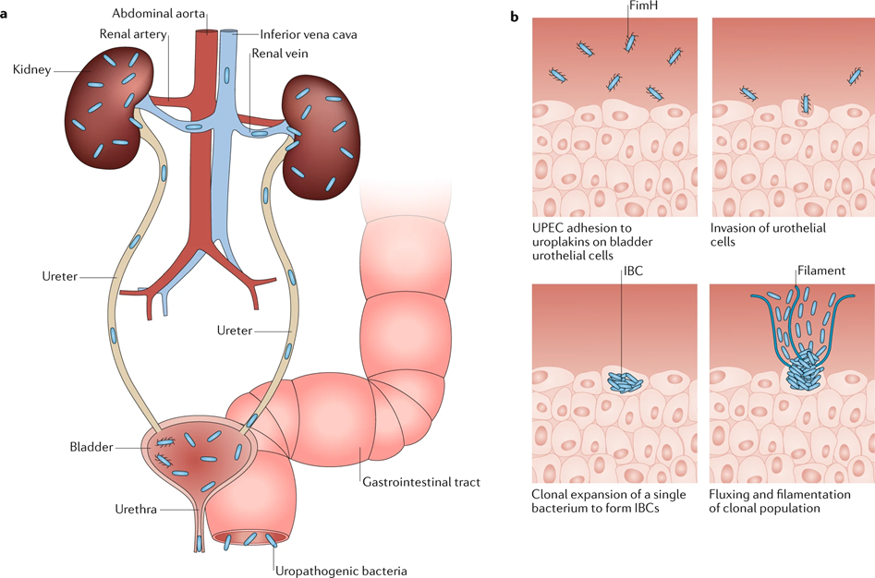
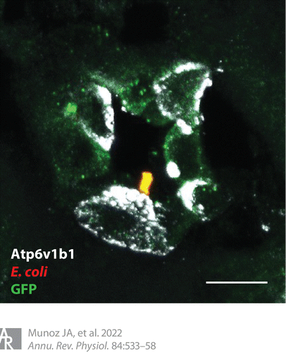
The Urobiome – Urinary Microbiota
From Columbia University O’Brien Center:
Klein & Hultgren, Nature Reviews Microbiology, 2020
Collaborating for the Advancement of Interdisciplinary Research in Benign Urology

Slide 11
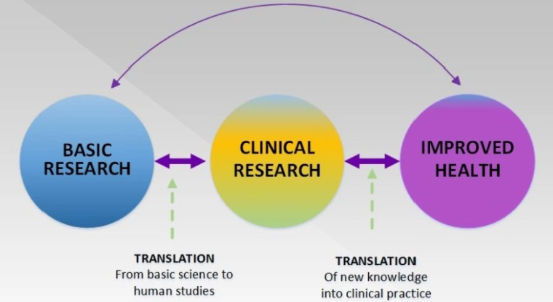
Benign Urology Research is Transdisciplinary
Research efforts of investigators from different disciplines working jointly to create new conceptual, theoretical, methodological, and translational innovations that integrate and move beyond discipline-specific approaches to address a common problem
Physiology
Pathology
Biology
Biochemistry
Immunology
Neurology
Toxicology
Nutrition science
Veterinary science
Pharmacology
Bioinformatics
Computer science
Engineering
Urology
Microbiology
Molecular biology
Genetics
Urologists, Urogynecologists, Nephrologists, Internists, Geriatricians, Nurses, Dietitians, Kinesiologists, Psychologists
Population Health Epidemiologists
Social Scientists
Clinicians/Surgeons
Collaborating for the Advancement of Interdisciplinary Research in Benign Urology

Slide 12
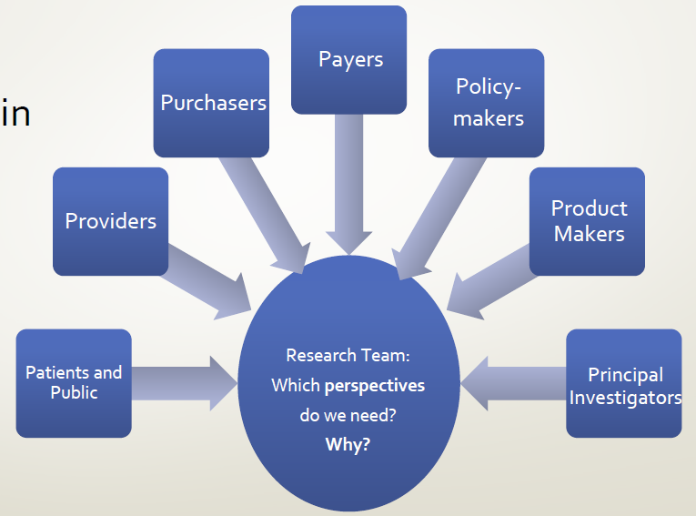
Benign Urology Research Engages Others
RESEARCH TEAM
Collaborating for the Advancement of Interdisciplinary Research in Benign Urology

Slide 13
















CAIRIBU
Collaborating for the Advancement of Interdisciplinary Research in Benign Urology
CAIRIBU Website URL: https://niddkcairibu.urology.wisc.edu
Collaborating for the Advancement of Interdisciplinary Research in Benign Urology

Slide 14
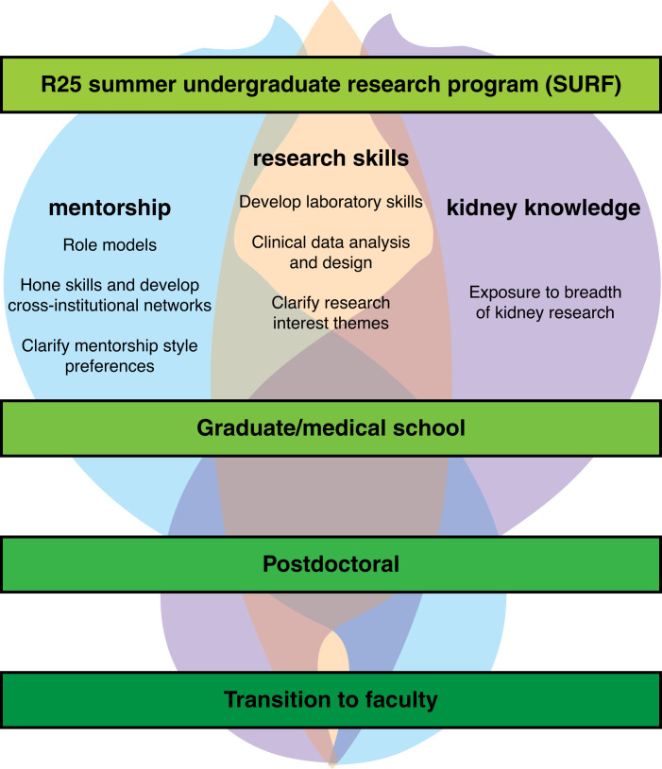
Building the Urology Researcher Pipeline
NIDDK funds summer undergraduate research fellowships to grow the field of urology and genitourinary research
The primary focus is to stimulate students’ interest in pursuing post-baccalaureate research careers
R25 Summer Undergraduate Research Programs
knowledge
of urology research
Figure adapted from Wilson et al, Kidney360 2022;3(3):546-549
Collaborating for the Advancement of Interdisciplinary Research in Benign Urology

Slide 15
Leaders in Urology Research
You will hear from the following during this summer:
Nathan Tykocki, PhD, Michigan State University Scientist (bladder, neurourology)
Douglas Strand, PhD, University of Texas Southwestern Scientist (prostate, bladder)
Allan Jhagroo, MD, University of Wisconsin-Madison Nephrologist
Aaron Miller, PhD, Cleveland Clinic Scientist (microbiome, urobiome)
Jill Macoska, PhD, University of Massachusetts Boston Scientist (prostate)
Teresa Liu, PhD, University of Wisconsin-Madison Scientist (prostate, aging)
Laura Preves Helgeson, UTI Health Patient
Nazema Siddiqui, MD, MHS, Duke University Urogynecologist
Alan Wolfe, PhD, Loyola University Chicago Scientist (microbiome, urobiome)
Whitney Sweeney, PhD, University of Wisconsin-Madison Scientist (team science)

Slide 16
Leaders in Urology Research
You will hear from the following during this summer:
LaTasha Crawford, PhD, VMD, University of Wisconsin-Madison Veterinarian Scientist (pain)
Alejandro Roldán-Alzate, PhD, University of Wisconsin-Madison Biomedical Engineer (bladder)
Hannah Ruetten, PhD, DVM, Wake Forest University Veterinarian Scientist (bladder)
Vinaya Bhatia, MD, University of Wisconsin-Madison Pediatric Urologist
Kathleen Kan, MD, Stanford University Pediatric Urologist
Naeem Bhojani, MD, Université de Montréal Urologist
Lauren Baker, PhD, DVM, University of Wisconsin-Madison Veterinarian Scientist (genetics)
Linda Baker, MD, Nationwide Children’s Hospital Pediatric Urologist
Walid Farhat, MD, University of Wisconsin-Madison Pediatric Urologist
Neil Paloian, MD, University of Wisconsin-Madison Pediatric Nephrologist
Maryellen Kelly, DNP, MHSc, Duke University Nurse Practitioner Scientist

