Slide 1
Communicating your Science: Abstracts and Posters

Slide 2
Abstracts

Slide 3
Step One: Check your guidelines
Requirements vary widely for different meetings, journals
Length limits
Discrete format vs. one paragraph
Templates
It’s a bit of game!

Slide 4
Introduction
Goal: limit to just the most essential info someone needs to know to understand your experiment
  1-3 brief sentences
What are you studying?
Why are you studying it?
Last sentence should be a smooth transition to methods (your experiment)

Slide 5
Examples
Dogs are a valuable spontaneous model for genetic research on calcium oxalate (CaOx) urinary stones. Like humans, most dogs with CaOx stones have idiopathic hypercalciuria. Our objective was to identify genetic variants that are associated with urinary calcium, blood ionized calcium, and CaOx stone development in dogs.
Patients requiring oral and/or enteral nutrition support for nutritional needs can form calcium oxalate (CaOx) kidney stones. Dietary oxalate, if excessive, can contribute to CaOx stones when unopposed by appropriate calcium. The oxalate concentration of oral/enteral nutrition formulas is not known. We assessed various formulas for oxalate.
Sonic hedgehog (Shh) signaling is critical in many developing organs and subject to disruption through gene-environment interactions. Urinary continence is dependent on appropriate development of bladder neck and urethra driven by epithelial-mesenchymal interactions mediated in part by SHH. To further understand the impact of Shh pathway disruption on lower urinary tract and continence, we examined voiding physiology and histology in compound mutant GLI family zinc finger Gli2^{+/−}; Gli3^{Δ699/+} mice, which have hypomorphic hedgehog signaling.

Slide 6
Methods: What did you do?
A brief description of your experiment
Who/What/How many?
What samples did you collect?
What did you measure?
What assay did you run to measure it?
What statistical analysis did you use to determine significance?
What you need to put here can be specific to your field
  Ask your PI for guidance!

Slide 7
Examples
Single nucleotide polymorphism (SNP) genotypes (>390,000) were available from 491 dogs (373 Miniature Schnauzers, 73 Bichons Frise, 45 Shih Tzus). Linear mixed model genome-wide association studies were performed for 3 traits with sex as a covariate: CaOx stones (219 cases, 131 controls), urine calcium:creatinine (149 dogs), and blood ionized calcium (137 dogs). Summary statistics were used with the multivariate adaptive shrinkage algorithm to identify associations shared across the traits. Significance was determined by local false sign rate (lfsr) <.05.
Voiding physiology was tested in young adult female mice (n=5-8/genotype) using void spot assay, uroflowmetry and ex vivo bladder bath assays. Urethra and bladder (n=3/genotype) were collected for immunostaining using antibodies against smooth muscle alpha actin to visualize urethral smooth muscle thickness, or uroplakin, transformation related protein 63, and keratin 5 (combinatorial staining resolves basal, intermediate and luminal epithelial cells).

Slide 8
Examples: Using tables/figures to your advantage
Some meetings allow tables/figures as part of the abstract submission
Usually accounts for some of your word limit
  E.g. CAIRIBU guidelines: Tables account for 225 characters per table. Graphics
  also account for 225 characters each.

Slide 9
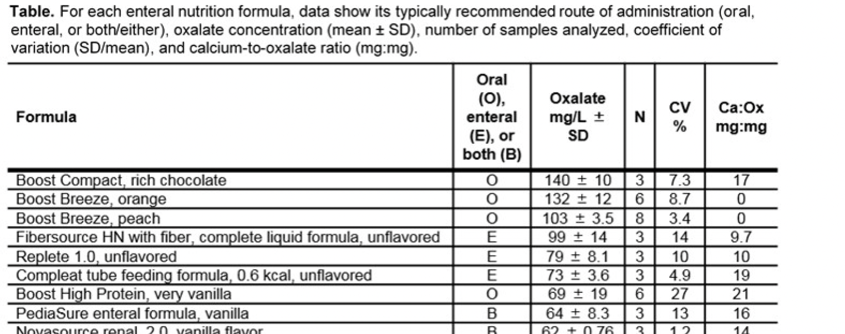
Examples: Using tables/figures to your advantage
Adult and pediatric oral/enteral nutrition formulas commonly used in hospitals as well as in home feeding regimens were selected. Formulas designed for oral and enteral consumption (or either) were included (table); completely elemental (hydrolyzed) or modular formula products were not. Multiple samples (N, table) of each formula were acidified, heated, and centrifuged. Supernatants were filtered and analyzed for oxalate by ion chromatography. Oxalate concentration (mg/L±SD), relative standard deviation (SD) between samples (coefficient of variation; CV), and calcium:oxalate ratios (mg:mg/L of formula) were calculated.

Slide 10
Results: What did you find?
Numbers, numbers, numbers
Reporting info on final dataset (exclusions, drop-outs, etc)
Reporting the results from your analyses (statistics)
  E.g. means, standard deviations, effect size, relative risk
Whether there a significant difference between groups
  P-values in parentheses
Use your methods as a guide—if reported in the methods, it should have a result

Slide 11
Examples
767 SNPs met significance. 10/22 top SNPs (lfsr <.01, Table 1) were within a haplotype on chromosome 15 containing a cluster of cytochrome p450 genes involved in arachidonic acid metabolism: CYP4A11, CYP4X1, and CYP4B1. Another notable gene was OCRL, a cause of Dent disease in humans.
Of 35 formulas analyzed, 9 were excluded due to inconsistent results and high CVs. Results for the 26 remaining formulas are shown (table). Oxalate concentration ranged from 4-140 mg oxalate/L of formula. Due to highly variable calcium content, calcium:oxalate ratios varied widely between formulas (from 0-286) with lower ratios suggesting higher potential for oxalate absorption. There was no difference between mean oxalate concentration of enteral vs. oral
formulas (45 vs. 46 mg/L; P=0.92). Formulas designated for enteral use tended to have lower relative SDs (mean CV 16% vs. 21% for oral formulas), likely due to the generally more complex matrix of oral formulas, which contributed to more analytical variability. Depending on the formula, a patient requiring 1.5 L daily could
obtain anywhere from 12-150 mg oxalate.

Slide 12
What is missing?
Gli2^{+/−}; Gli3^{Δ699/+} female mice void more urine spots, void more spots of smaller diameter and void a greater percentage of urine in the cage center than wild type mice. Voids from Gli2^{+/−}; Gli3^{Δ699/+} mice, measured by uroflowmetry, weigh less (indicating smaller volume) and are shorter in duration than wild type mice. Gli2^{+/−}; Gli3^{Δ699/+} female mouse bladders, isolated in ex vivo bath preparations, are less responsive to electrical field stimulation and potassium chloride than bladders from wild type mice. Our results are consistent with detrusor under activity and potential stress incontinence in Gli2^{+/−}; Gli3^{Δ699/+} female mice. In search for a physiological mechanism, we conducted histological analysis to reveal a clear anatomic boundary between wild type mouse bladder neck and urethra. Umbrella shaped uroplakin+ cells populate the bladder neck and cuboidal shaped uroplakin- superficial cells populate the urethra. The bladder neck epithelium of Gli2^{+/−}; Gli3^{Δ699/+} mice does not appreciably differ from wild type, but urethral epithelial cells are uroplakin+, suggesting possible segmental deficits during urethral development that may account in part for incontinence in Gli2^{+/−}; Gli3^{Δ699/+} mice.

Slide 13
Conclusions: The big picture
Main finding from your study
  ~2 sentences
Implications of your finding
What is your takeaway message?
+/- future direction

Slide 14
Examples
Intermittent reports have linked arachidonic acid metabolism, calcium homeostasis and kidney stones, with focus on dietary intake as a risk factor. Our findings suggest this link may be related to a genetic anomaly in arachidonic acid metabolism.
Patients requiring oral and/or enteral nutrition support are at risk for a high exogenous oxalate load depending on the formula ingested and on the bioavailability of oxalate. Patients with a history of or at high risk for urolithiasis would benefit from strategies to reduce the bioavailability of oxalate and urinary oxalate excretion, which may include supplemental calcium with feedings or use of an appropriate lower oxalate formula.
Our data suggest that establishing continent voiding function in mice is dependent on appropriate urethra epithelial cell fate. Future work to understand mechanisms underlying decreased bladder contractile properties, and urethral cell fate will enhance understanding of the continence mechanism.

Slide 15
General advice
Just start writing
Make it long, then edit
Peer review
As much as possible, take an objective point of view
  Have I defined abbreviations?
  Have I explained the purpose of the study?
  Have I reported on each of the things I mentioned in methods?
  Are my conclusions clear and conicse?

Slide 16
Activity: Abstract Critique
Notes:
Cairibu 2020_bakerfinal

Slide 17
Scientific Posters

Slide 18
What is a poster?
A graphical representation of your abstract
  Separate sections for intro, methods, results, conclusions
Limit text as much as possible
  Less than 1000 words
A visual guide for an experimental elevator pitch
  A 1-2 minute ‘speech’ explaining what you did, how you did it, and why it was important
Marketing for your science
  Advertisement for your lab

Slide 19
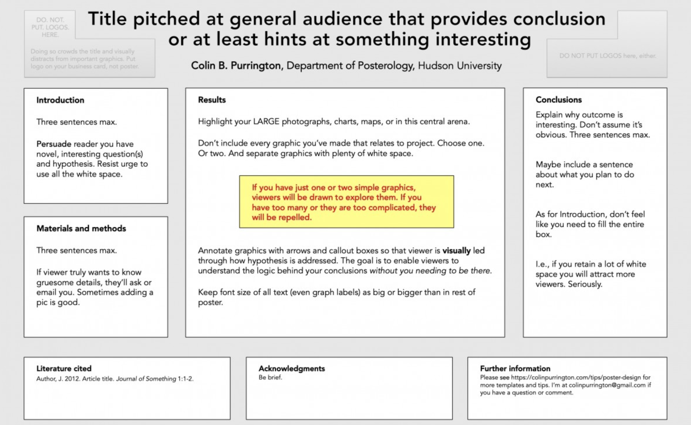

Slide 20
First: Check your guidelines for size!
Meeting guidelines will tell you size of poster boards
You can change size of slide in Powerpoint, etc
  Design>Slide Size>Page Setup
  Maximum length/width is less than most posters, set for half of poster size and double it when sending to the printer

Slide 21
Title
Should be descriptive of your findings
Try to make it interesting
Example:
  “Genetic and RNA sequencing study of kidney stones in dogs” vs.
  “Expression quantitive trait loci (eQTL) analysis identifies genetic mutation affecting CASR expression is associated with spontaneous kidney stone disease in Miniature Schnauzer dogs”
Look at the conclusion from your abstract for guidance

Slide 22
Conclusions from abstracts: Can you make a title?
Intermittent reports have linked arachidonic acid metabolism, calcium homeostasis and kidney stones, with focus on dietary intake as a risk factor. Our findings suggest this link may be related to a genetic anomaly in arachidonic acid metabolism.
Patients requiring oral and/or enteral nutrition support are at risk for a high exogenous oxalate load depending on the formula ingested and on the bioavailability of oxalate. Patients with a history of or at high risk for urolithiasis would benefit from strategies to reduce the bioavailability of oxalate and urinary oxalate excretion, which may include supplemental calcium with feedings or use of an appropriate lower oxalate formula.
Our data suggest that establishing continent voiding function in mice is dependent on appropriate urethra epithelial cell fate. Future work to understand mechanisms underlying decreased bladder contractile properties, and urethral cell fate will enhance understanding of the continence mechanism.

Slide 23
Should I include the abstract on my poster?
No
The poster IS the abstract
Looks very wordy on the poster
Takes up valuable space

Slide 24
Introduction
Use your abstract as a guide
Audience: Someone who knows science, but is probably unfamiliar with your specific topic
What are you studying and why is it important?
1-2 bullet points to establish background/importance
What does someone need to know to understand what you did?
State your hypothesis here

Slide 25
Materials and Methods
Explain what you did, brevity is key
Mention your statistical analysis
Can you include a photograph?
Can you make your experimental design into a figure?

Slide 26
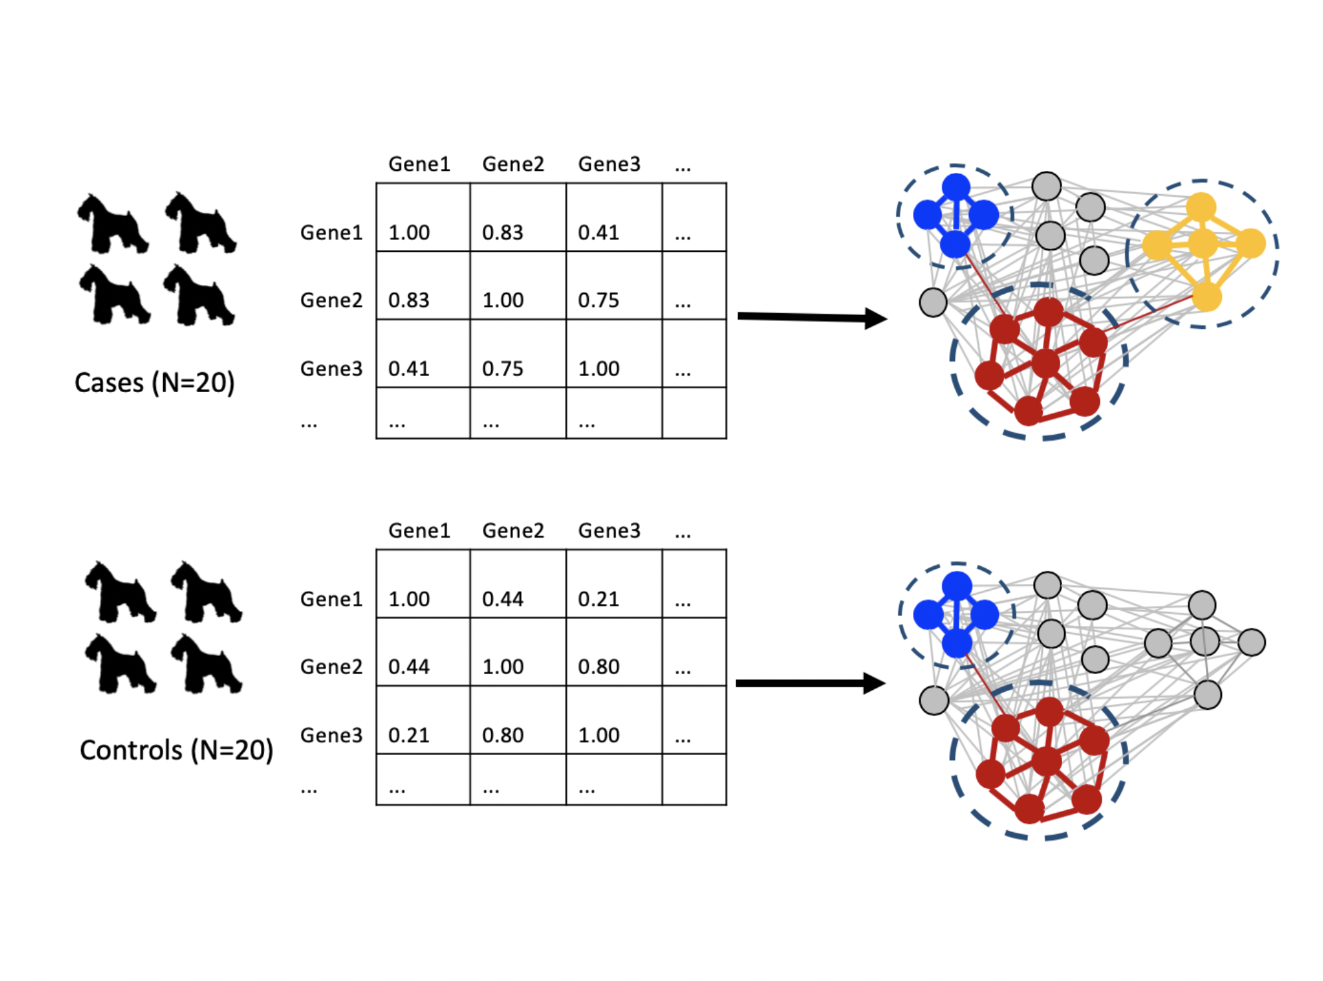

Slide 27
Results
Should take up the most space
Lead with whether your experiment worked
  “135 SNPs met genome wide significance”
  “Diabetic patients who were also taller than average were significantly more likely to develop kidney stones”
Don’t tell them, show them
Tables are fine, graphs/figures are better

Slide 28
Conclusions
State your major result
Why is this interesting?
What is the relevance of this finding to the broader scientific community?
Include a sentence or 2 about future directions for this work

Slide 29
Acknowledgements
Briefly thank individuals for specific contributions to the work
List funding sources for the study/individuals involved in the study
List disclosures or conflicts of interest

Slide 30
Literature Cited
Cite any key information from the intro or methods
Usually limited to just a few citations

Slide 31
Do’s and Don’ts
#1 mistake: too much text
Do not use an image as the background
Avoid dark backgrounds with dark text
Avoid red/green color scheme, don’t over-rely on color in your graphs (use symbols)
Annotate figure legends so they can stand on their own
Your poster should be able to be comfortably viewed from ~a few feet away—keep this in mind when choosing font and image sizes
More here: https://colinpurrington.com/tips/poster-design/

Slide 32
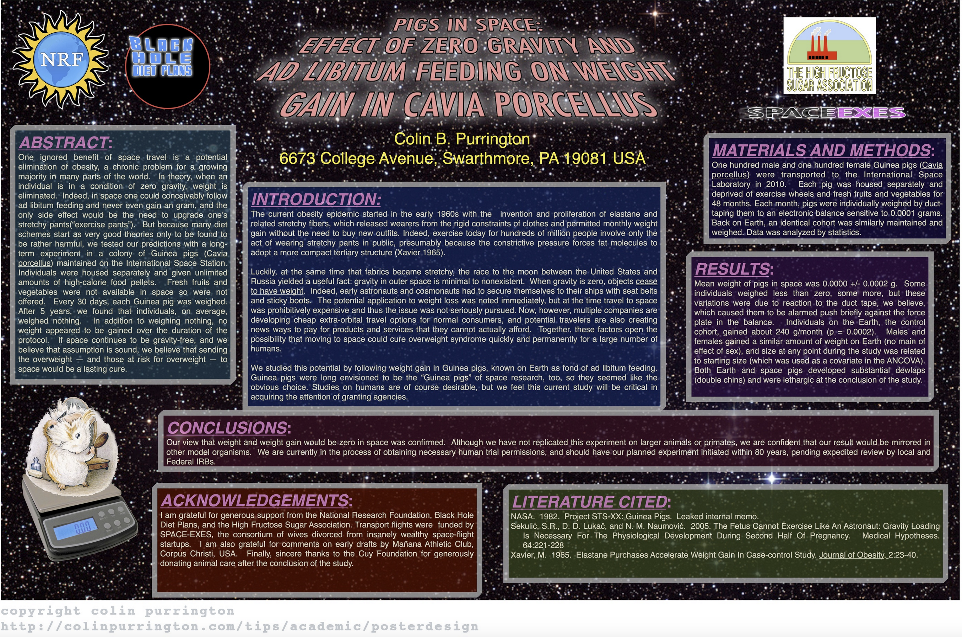

Slide 33
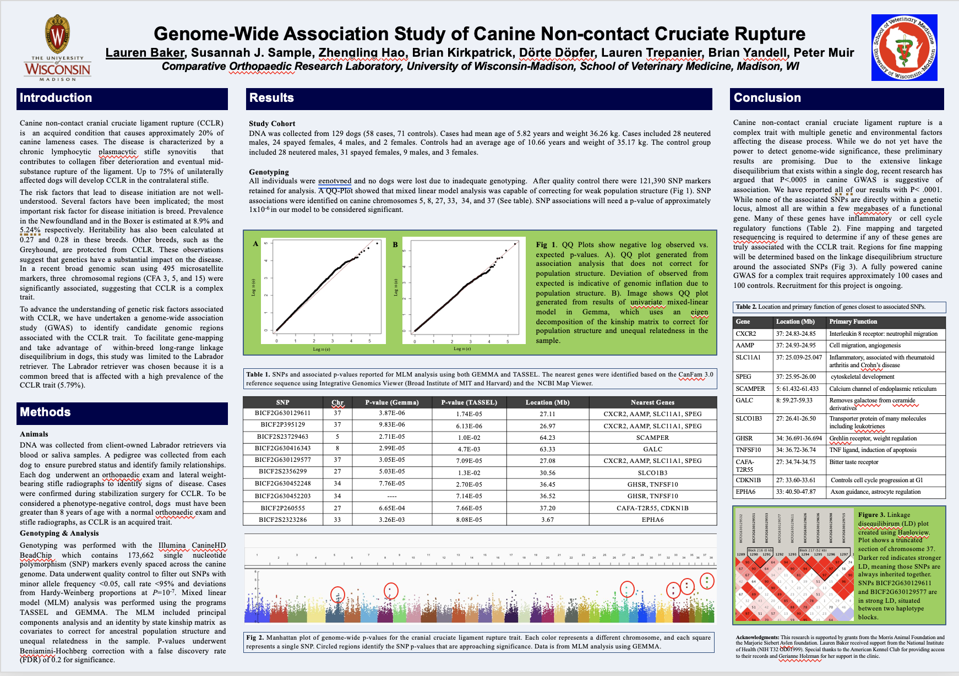

Slide 34
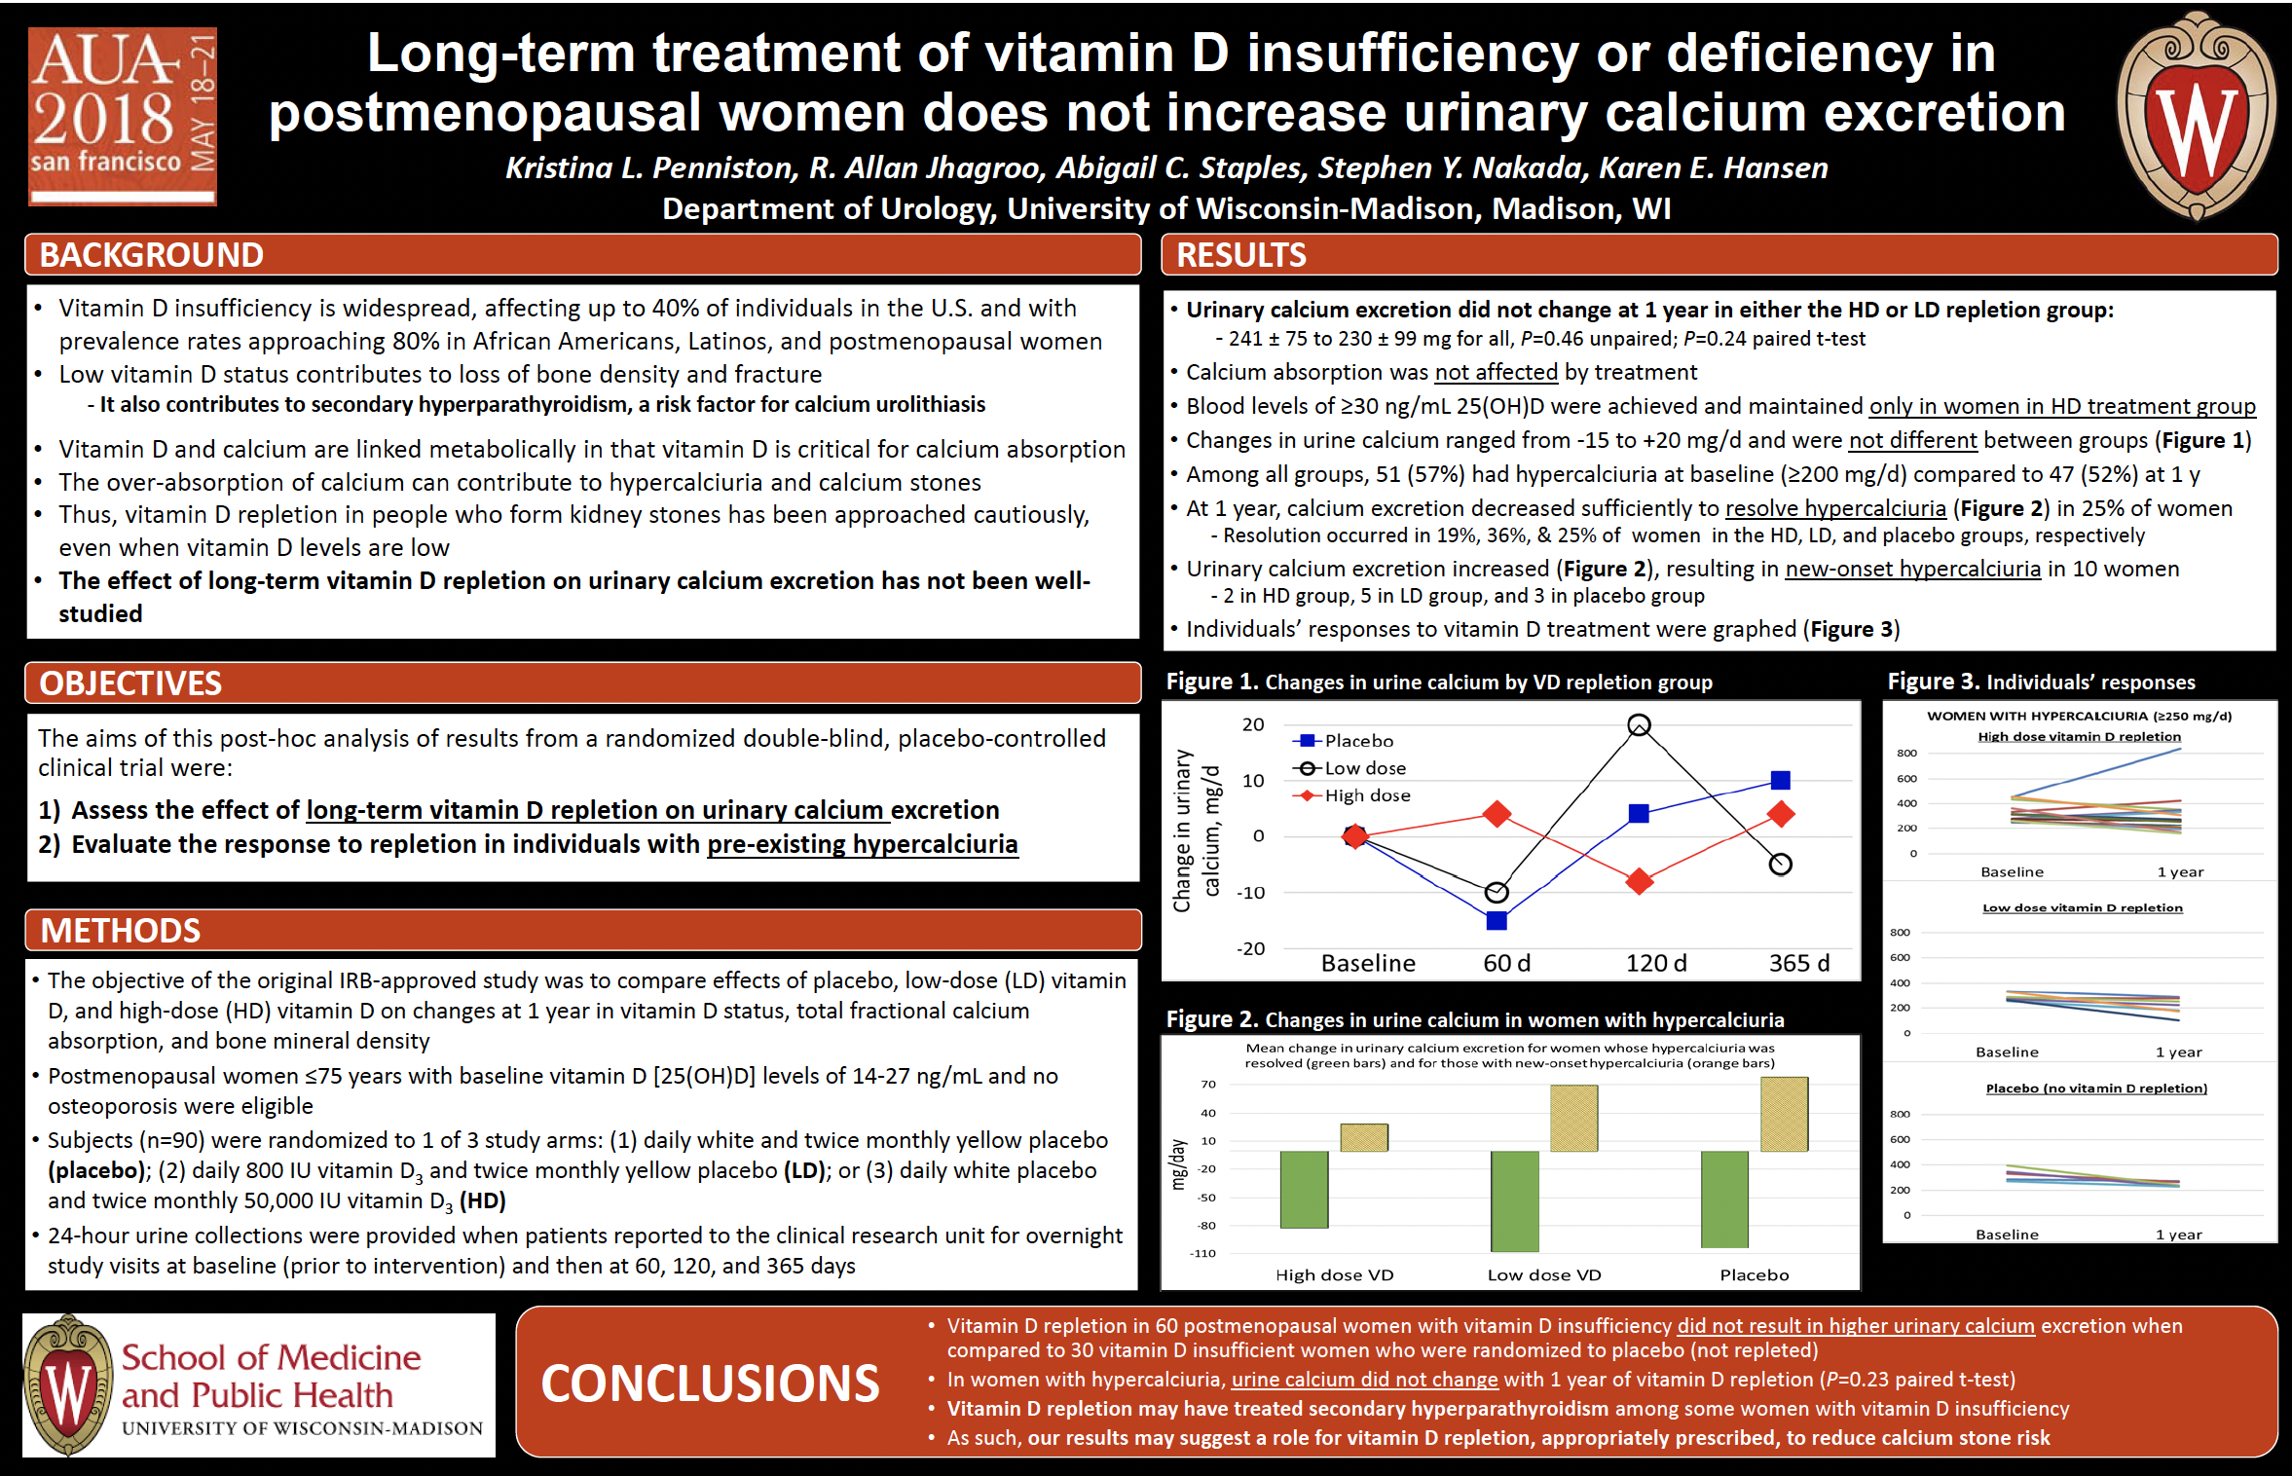

Slide 35
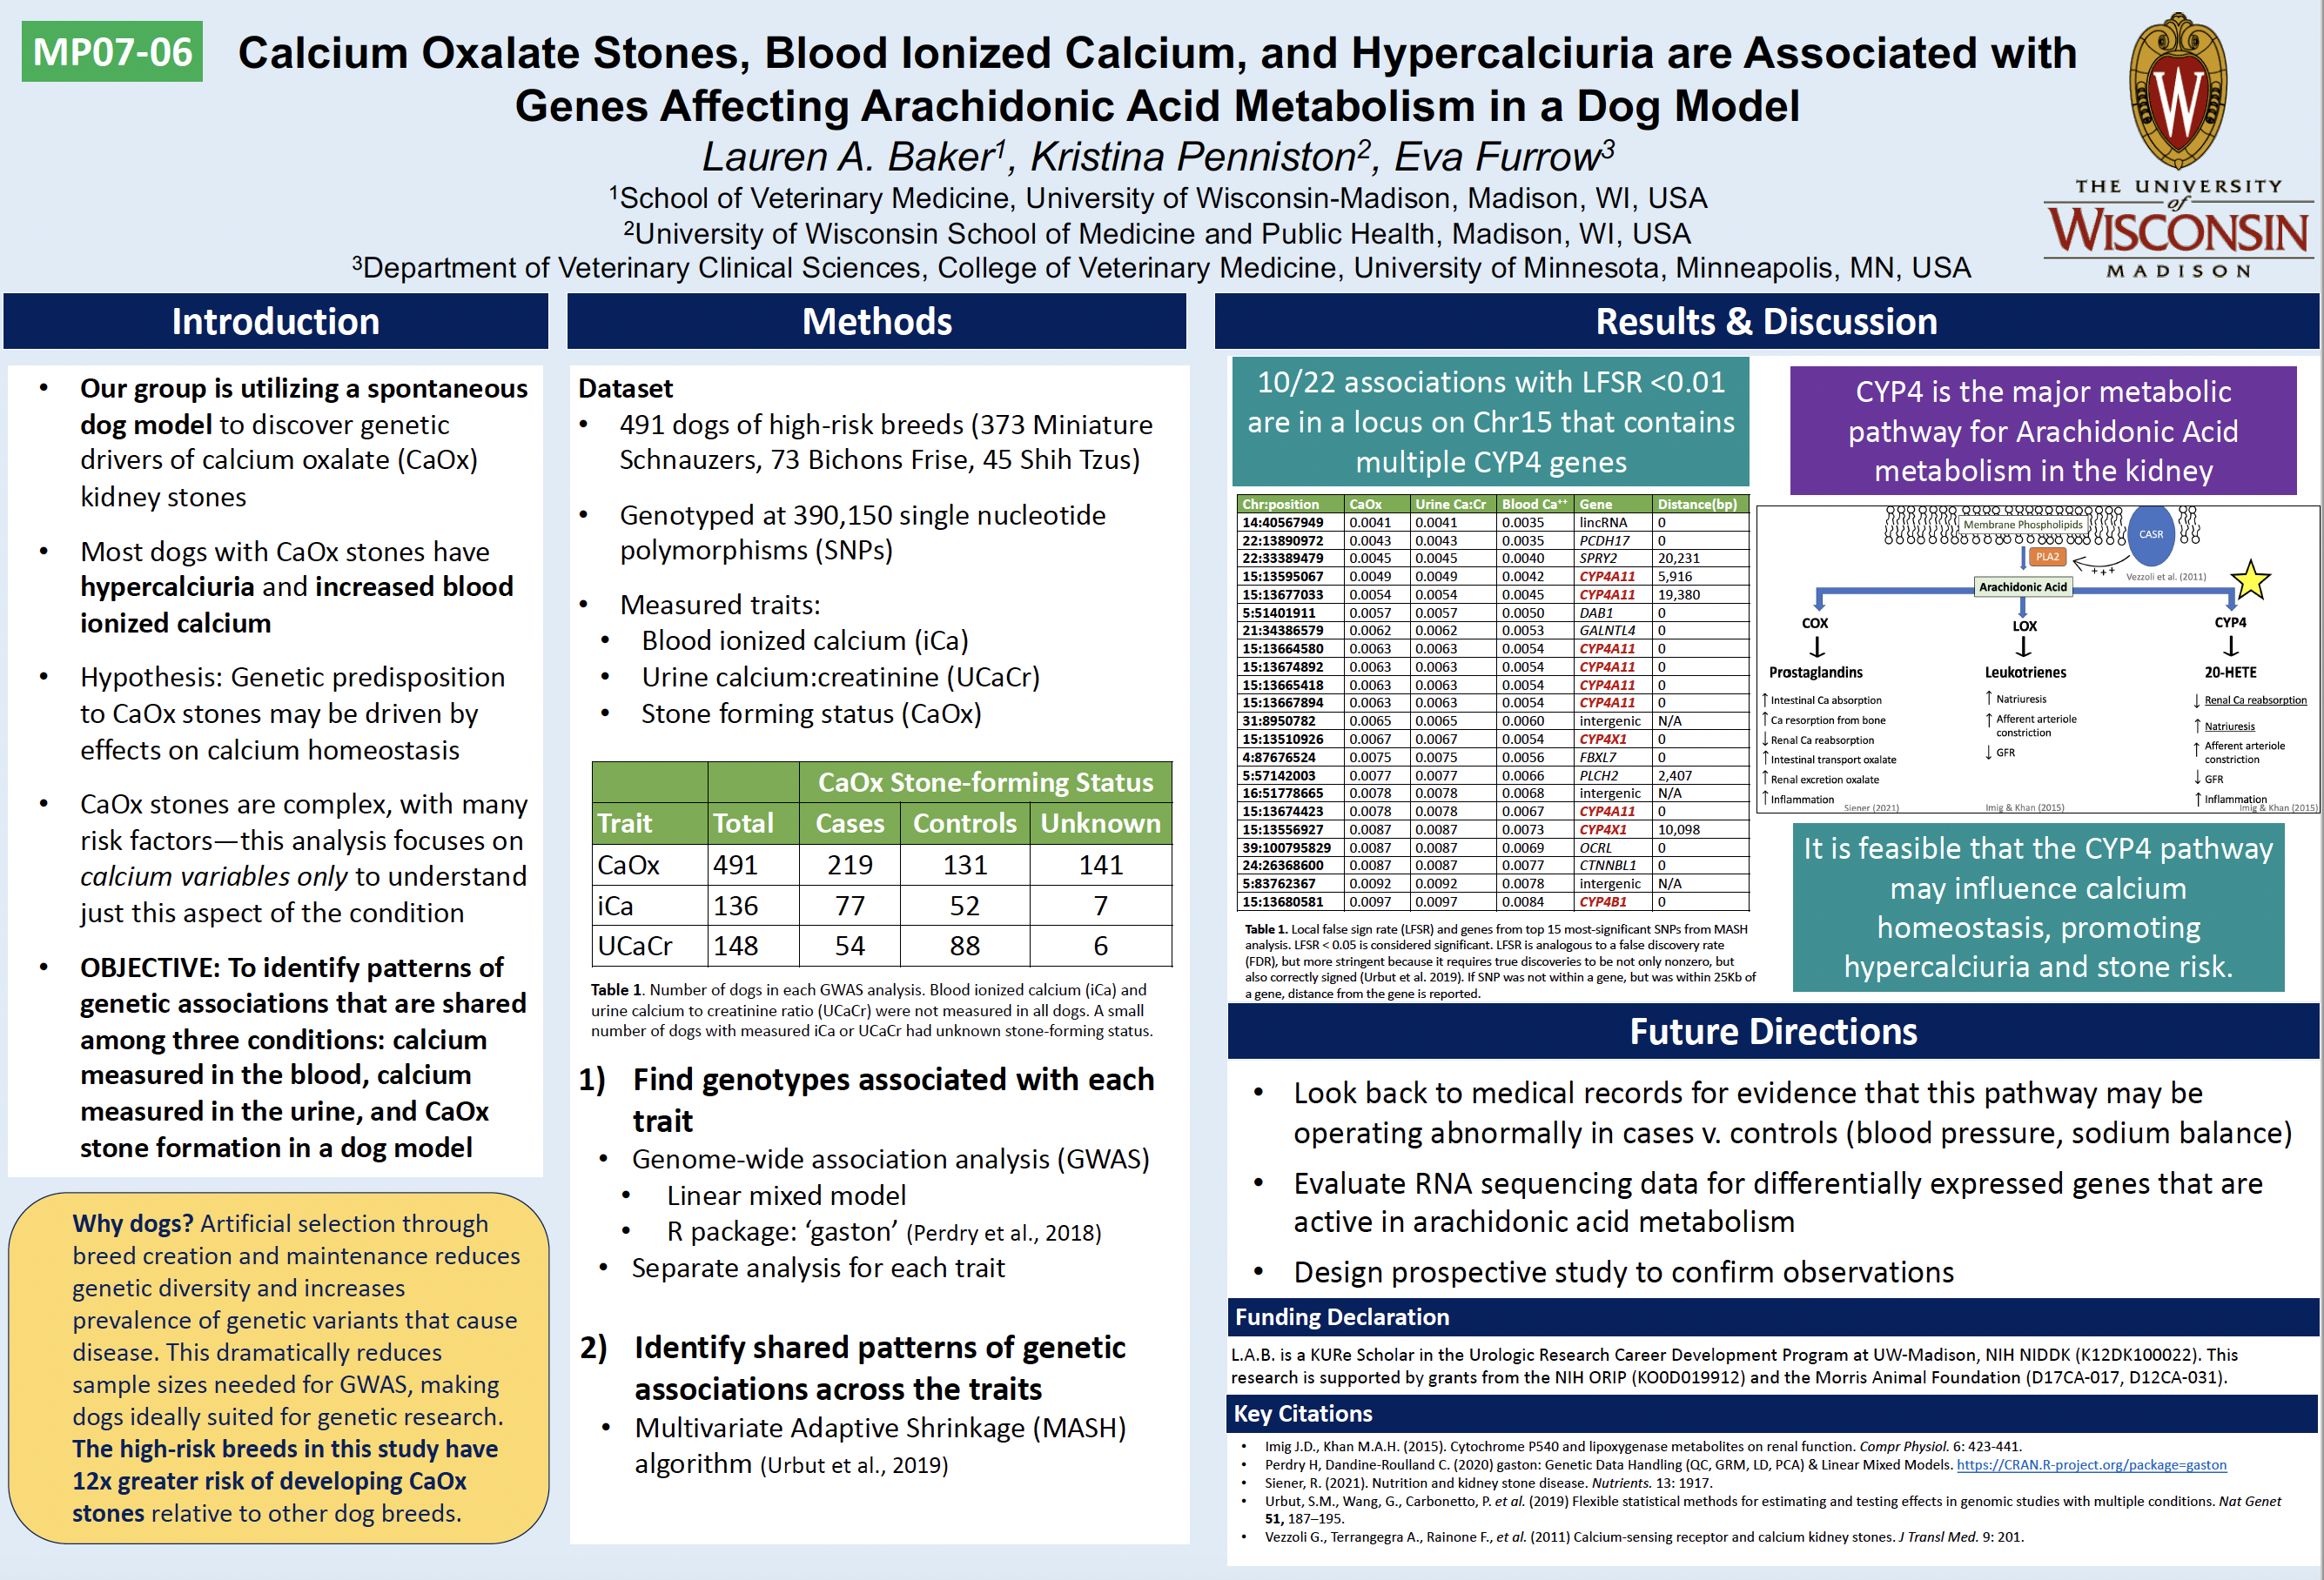

Slide 36
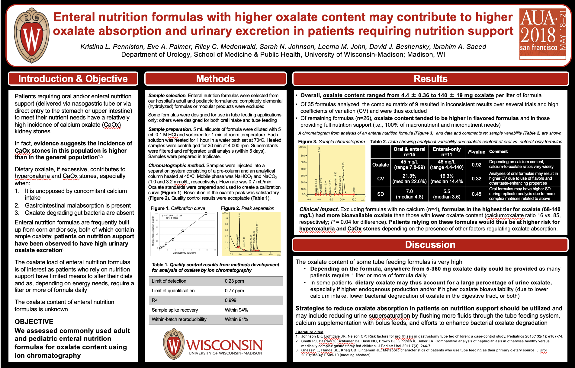

Slide 37
Resources
POSTERS
1. Links online to “good” and “bad” poster (with accompanying critique: https://cpb-us-e1.wpmucdn.com/sites.psu.edu/dist/a/36309/files/2016/04/Posters-The-Good-and-the-Bad.pdf
2. Tips on designing good poster: https://colinpurrington.com/tips/poster-design/
3. On this page are “best posters” from trainees at the 2021 CAIRIBU meeting: https://cairibu.urology.wisc.edu/2021-annual-meeting-materials/
ABSTRACTS
1. Link to abstract booklet for the 2022 CAIRIBU meeting (includes the guidelines for how abstracts should be structured): https://cairibu.urology.wisc.edu/wp-content/uploads/sites/1064/2023/12/CAIRIBU-MEETING-ABSTRACTS-BOOKLET.pdf
2. Link to nice publication on writing an abstract for a scientific meeting: https://www.ncbi.nlm.nih.gov/pmc/articles/PMC3136027/#:~:text=The%20usual%20sections%20defined%20in,Findings%20in%20place%20of%20Results).

