Slide 1

Developing Your Professional Resume and Curriculum Vitae
Strategies for crafting impactful job application documents
Notes:
---

Slide 2
Workshop Introduction and Objectives
Notes:
Purpose of the Resume and CV Workshop, Learning Objectives and Workshop Structure

Slide 3
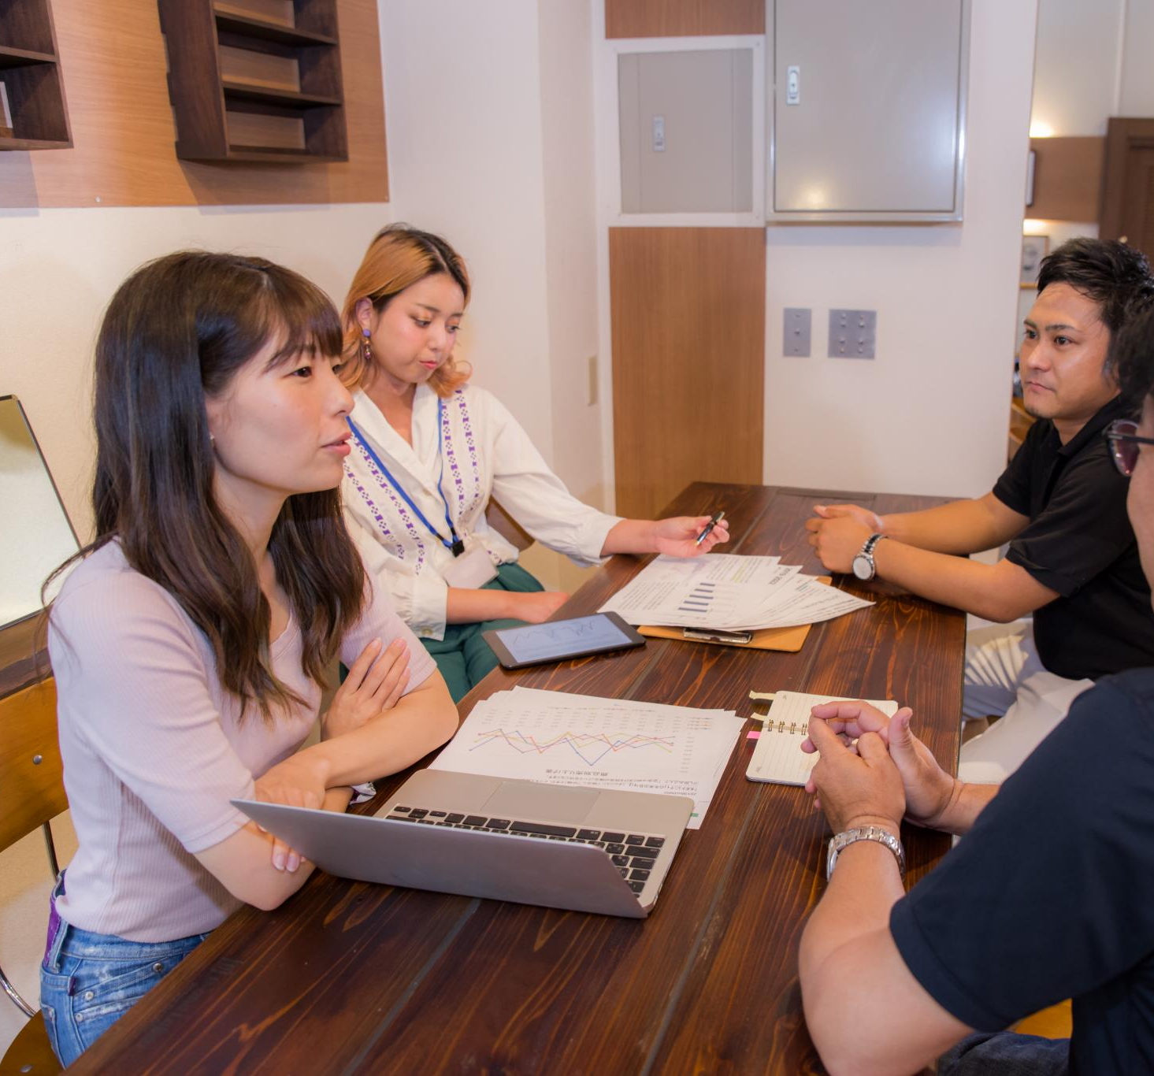
Purpose of the Resume and CV Workshop
Importance of Resumes and CVs
  Resumes and CVs are key tools that create first impressions for employers and academic selectors.
Resumes as Living Documents
  Resumes and CVs should evolve with new experiences and skills, reflecting ongoing growth.
Workshop Engagement
  Active participation, peer feedback, and hands-on practice enhance learning and document quality.
Long-Term Career Skills
  Skills learned apply beyond single applications, aiding long-term career development.
Notes:
This opening section of the workshop is designed to establish a shared understanding of why professional resumes and curricula vitae (CVs) are critical tools for undergraduate students as they transition from academic settings into professional, research, or graduate-school environments. A resume or CV is often the first impression an employer, faculty member, or selection committee has of a candidate, and its quality can strongly influence whether the candidate advances to the next stage of an application process. This workshop emphasizes that resumes and CVs are not static documents, but living records that should evolve as students gain new experiences, skills, and accomplishments. Students are encouraged to view these documents as strategic communication tools rather than simple lists of activities. The session also sets expectations for active participation, peer feedback, and hands-on practice, reinforcing that learning how to develop strong application materials requires reflection, iteration, and constructive critique. By framing the workshop as a supportive and skill-building environment, students are invited to engage honestly with their current materials and identify areas for growth. This introduction also highlights how the workshop will balance short instructional segments with interactive activities, ensuring that students not only learn best practices but also apply them immediately. Finally, this section clarifies that the skills learned are transferable beyond a single job application, supporting long-term career development across multiple professional pathways.

Slide 4

Learning Objectives and Workshop Structure
Clear Learning Objectives
  Defines key goals including understanding resumes vs CVs, bullet writing, and tailoring applications.
Workshop Phases
  Structured into lectures, discussions, peer critiques, and individual work with facilitator support.
Interactive Learning Focus
  Emphasizes active participation and practice to build confidence and competence in document preparation.
Progress over Perfection
  Encourages making meaningful changes rather than perfect documents to foster growth and improvement.
Notes:
This slide outlines the specific learning objectives that guide the structure of the two-hour workshop and provide students with clear expectations for what they will gain. The primary objectives include understanding the fundamental differences between a resume and a CV, identifying the essential components of each document, learning how to write strong and effective bullet points, and developing the ability to tailor application materials to specific opportunities. By explicitly stating these goals, students can better track their own progress and focus their attention during each activity. This section also explains how the workshop is organized into distinct phases, including brief lectures, guided discussions, peer-based critique exercises, and individual work time with facilitator support. Emphasizing this structure helps students understand why interactive components are central to the learning process and reassures them that they will have time to apply concepts to their own documents. The objectives also reinforce that improvement does not require perfection; instead, the focus is on making meaningful, actionable changes. By aligning objectives with activities, this slide serves as a roadmap for the session and helps students see how each component contributes to building confidence and competence in professional self-presentation.

Slide 5
Understanding Resumes and CVs
Notes:
What Is a Resume?, What Is a Curriculum Vitae (CV)?

Slide 6
What Is a Resume?
Definition and Purpose
  A resume is a concise document summarizing education, skills, and experiences tailored to a specific job or internship.
Tailoring and Prioritization
  Resumes should be customized for each opportunity, emphasizing relevant experiences that demonstrate job fit.
Key Resume Sections
  Typical resume sections include contact information, education, experience, and skills, arranged clearly for fast reading.
Clarity and Organization
  Employers scan resumes quickly, so clarity, organization, and relevance are essential to capture attention.
Notes:
This section provides a clear and practical explanation of what a resume is and how it is typically used in professional contexts. A resume is generally a concise, targeted document, usually one page for undergraduates, that summarizes a candidate’s education, relevant experiences, and skills as they relate to a specific job or internship. Emphasis is placed on the idea that resumes should be tailored for each opportunity, rather than reused unchanged across applications. Students learn that employers often spend only a short amount of time scanning resumes, which makes clarity, organization, and relevance essential. This slide also introduces the concept of prioritization, encouraging students to highlight experiences that best demonstrate their fit for the role rather than attempting to include everything they have ever done. Common resume sections such as contact information, education, experience, and skills are introduced at a high level, setting the stage for deeper discussion later in the workshop. By understanding the purpose and expectations of a resume, students can begin to think strategically about how to present their experiences in a way that aligns with employer needs and communicates value efficiently.

Slide 7

What Is a Curriculum Vitae (CV)?
Definition of a CV
  A CV is a detailed academic document outlining a student’s education, research, and scholarly activities.
Difference from Resume
  CVs differ from resumes by being longer and focusing on depth rather than brevity, serving academic and research roles.
Content and Growth
  CVs include research, presentations, awards, and grow over time with a student's academic achievements.
Appropriate Uses
  CVs are used for graduate applications, research roles, and academic fellowships where detailed records are required.
Notes:
This section focuses on defining the curriculum vitae (CV) and distinguishing it from a resume. A CV is a more comprehensive and detailed document commonly used in academic, research, medical, and some international contexts. Unlike a resume, a CV is not limited to one or two pages and is designed to provide a complete record of a student’s academic background and scholarly activities. This may include sections on research experience, publications, presentations, teaching experience, grants, awards, and professional affiliations. Students are guided to understand that CVs emphasize depth and breadth rather than brevity, and that they are often expected to grow over time as academic accomplishments accumulate. This slide also addresses common misconceptions, such as the belief that a CV is simply a longer resume, by clarifying that the two documents serve different audiences and purposes. Understanding when and why a CV is appropriate helps students make informed decisions about which document to use in different application scenarios, such as applying to graduate programs, research positions, or academic fellowships.

Slide 8
Building Strong Resume and CV Content
Notes:
Key Sections and Common Mistakes, Writing Strong Bullet Points

Slide 9
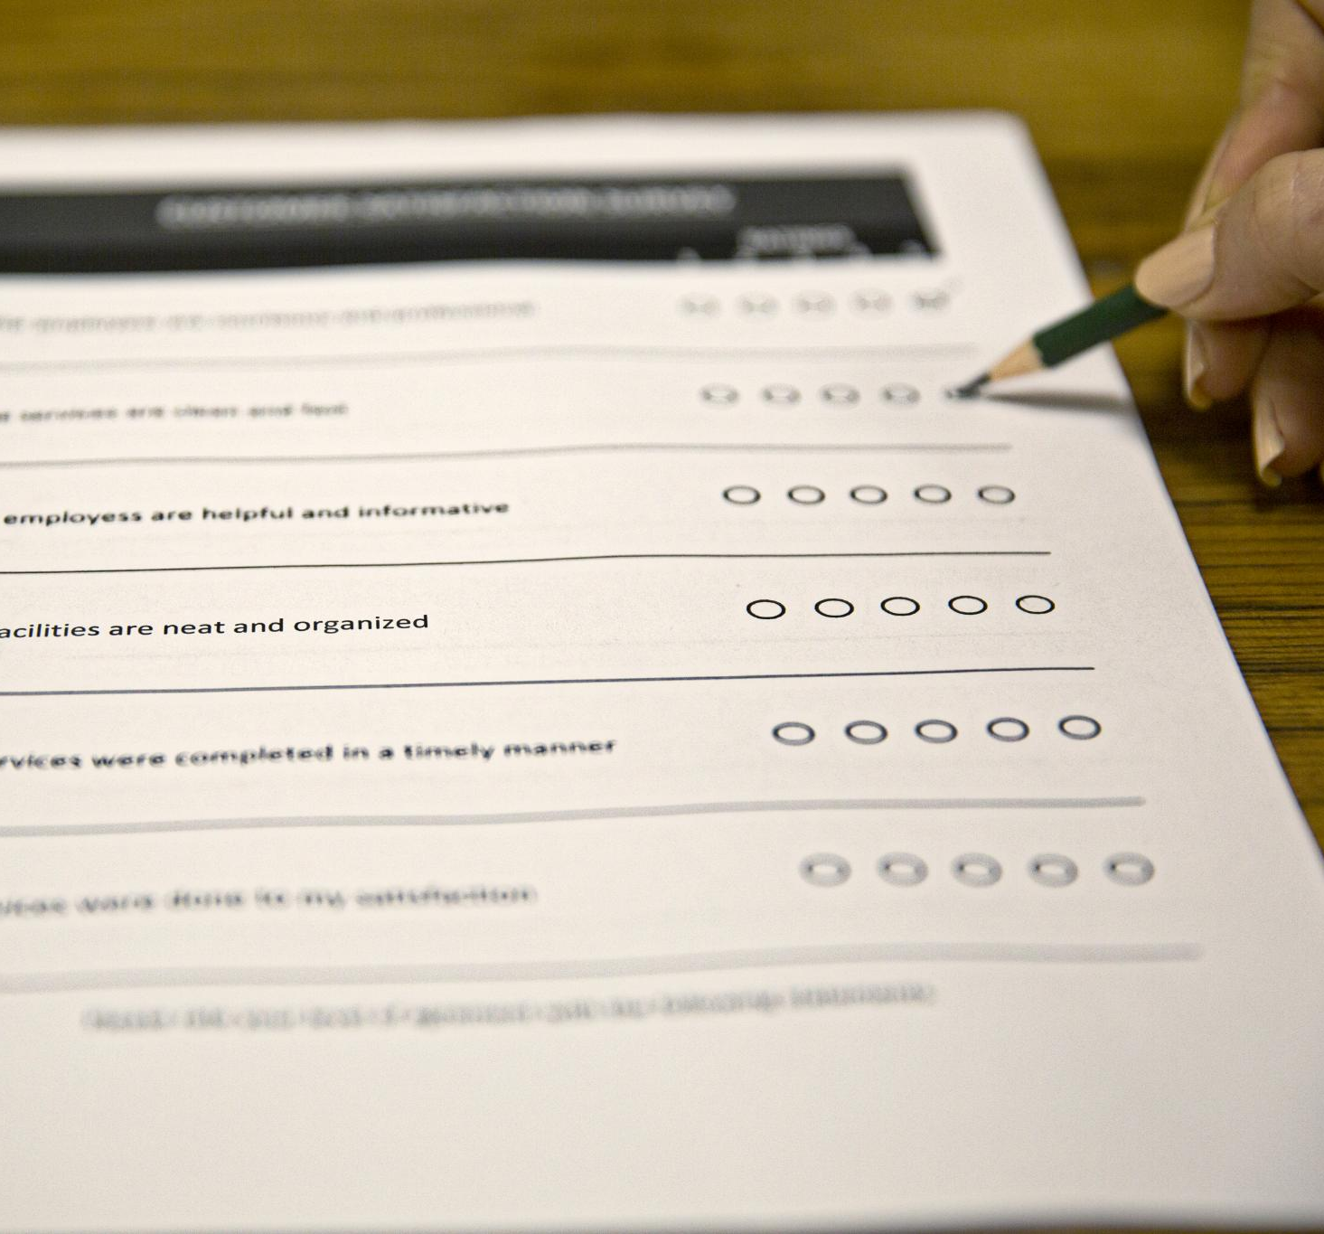
Key Sections and Common Mistakes
Essential Resume Sections
  Core sections include education, experience, and skills, with emphasis varying by opportunity.
Common Resume Mistakes
  Frequent errors include vague descriptions, inconsistent formatting, and grammatical mistakes.
Importance of Presentation
  Clear, consistent, and detailed presentation prevents strong experiences from being undermined.
Growth Mindset Approach
  Mistakes should be seen as opportunities for improvement, supporting learning and revision.
Notes:
This section examines the core sections that appear in most resumes and CVs while also highlighting frequent mistakes that can weaken an application. Students are walked through essential sections such as education, experience, and skills, with discussion of how the order and emphasis of these sections may vary depending on the opportunity. The slide also addresses common pitfalls, including vague descriptions, inconsistent formatting, overuse of buzzwords, and grammatical errors. By reviewing these mistakes explicitly, students learn to recognize issues that may otherwise go unnoticed in their own documents. This content reinforces the importance of clarity, consistency, and attention to detail, emphasizing that even strong experiences can be undermined by poor presentation. Students are encouraged to view mistakes not as personal failures but as opportunities for revision and improvement. This framing supports a growth mindset and prepares students for the upcoming critique activity, where they will practice identifying strengths and weaknesses in sample resumes.

Slide 10

Writing Strong Bullet Points
Use of Action Verbs
  Strong bullet points begin with dynamic action verbs to clearly communicate skills and achievements.
Describe Tasks and Results
  Effective bullet points detail specific tasks and highlight measurable outcomes and contributions.
Tailor to Job Descriptions
  Bullet points should be tailored to align with employer expectations and relevant job descriptions.
Repeatable Structure
  Following a repeatable structure helps create clear, impactful bullet points across roles and experiences.
Notes:
This slide introduces students to strategies for writing effective bullet points that clearly communicate skills and impact. The focus is on using action verbs, describing specific tasks, and highlighting results or outcomes whenever possible. Students learn that strong bullet points go beyond listing responsibilities and instead demonstrate contributions and achievements. Examples are used to show how vague statements can be transformed into compelling descriptions by adding detail and quantification. This section also emphasizes the importance of tailoring language to match job descriptions and employer expectations. By learning a repeatable structure for bullet points, students gain a practical tool they can apply across different roles and experiences. This content directly supports the interactive rewriting activity later in the workshop, ensuring that students have both conceptual understanding and concrete examples before practicing on their own materials.

Slide 11
Interactive Application and Wrap-Up
Notes:
Resume Critique and Improvement Activities, Choosing Between a Resume and a CV and Next Steps

Slide 12

Resume Critique and Improvement Activities
Collaborative Resume Analysis
  Students work together to evaluate sample resumes, identifying key strengths and areas needing improvement.
Constructive Peer Feedback
  The activity encourages open discussion and constructive criticism to understand diverse formatting and content strategies.
Resume Revision Practice
  Students apply feedback to enhance clarity, bullet points, and relevance in their own resumes with facilitator support.
Notes:
This section supports the interactive components of the workshop, where students apply what they have learned through critique and revision exercises. Students work collaboratively to analyze sample resumes, identifying strengths, weaknesses, and opportunities for improvement. This peer-based approach helps students develop critical evaluation skills while also exposing them to different formatting styles and content strategies. The activity encourages constructive feedback and discussion, reinforcing that multiple approaches can be effective when aligned with best practices. Following the critique, students begin revising their own resumes or CVs, focusing on improving bullet points, clarity, and relevance. Facilitator guidance during this time helps ensure that feedback is accurate and supportive. This applied practice is essential for translating abstract concepts into tangible improvements and builds student confidence in their ability to independently refine their professional documents.

Slide 13

Choosing Between a Resume and a CV and Next Steps
Decision Making Process
  Students engage in scenario-based discussions to determine when to use a resume or a CV for different opportunities.
Reflection and Action
  Students identify specific changes for their documents to improve based on workshop learnings and plan next steps.
Ongoing Development
  Emphasizes resume and CV development as continuous, encouraging feedback from mentors and peers for refinement.
Notes:
The final section of the workshop helps students consolidate their learning by revisiting the decision-making process for choosing between a resume and a CV. Through scenario-based discussion, students practice identifying which document is appropriate for different academic and professional opportunities. This reinforces earlier content and helps ensure that students can apply their knowledge in real-world contexts. The slide also encourages reflection, prompting students to identify at least one specific change they plan to make to their document after the workshop. By ending with actionable next steps, this section emphasizes that resume and CV development is an ongoing process. Students are encouraged to seek additional feedback from career services, faculty mentors, or peers and to continue refining their materials as they gain new experiences. This concluding content reinforces the workshop’s goal of empowering students with practical skills and a clear path forward.

